Slide 1
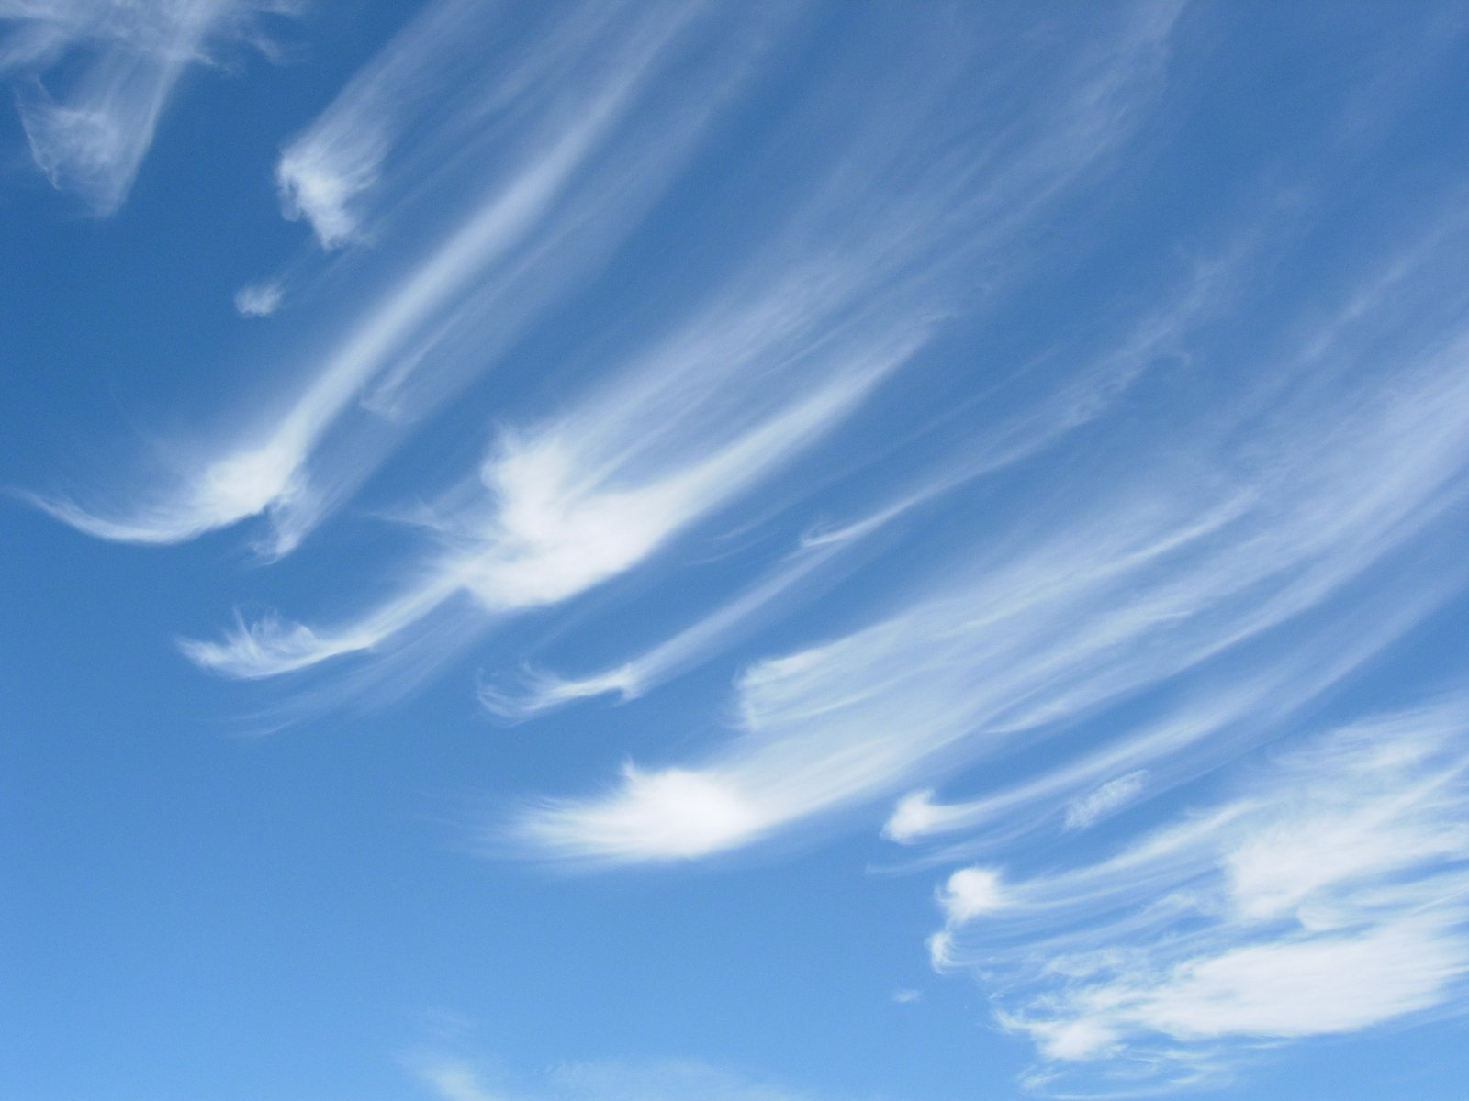
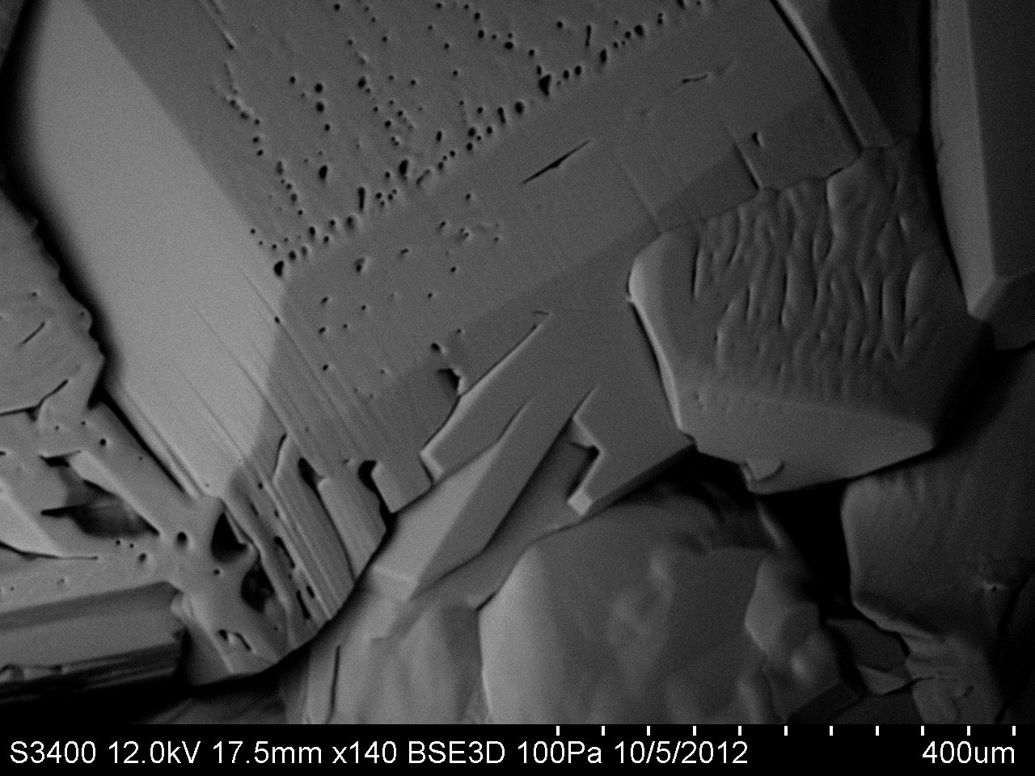
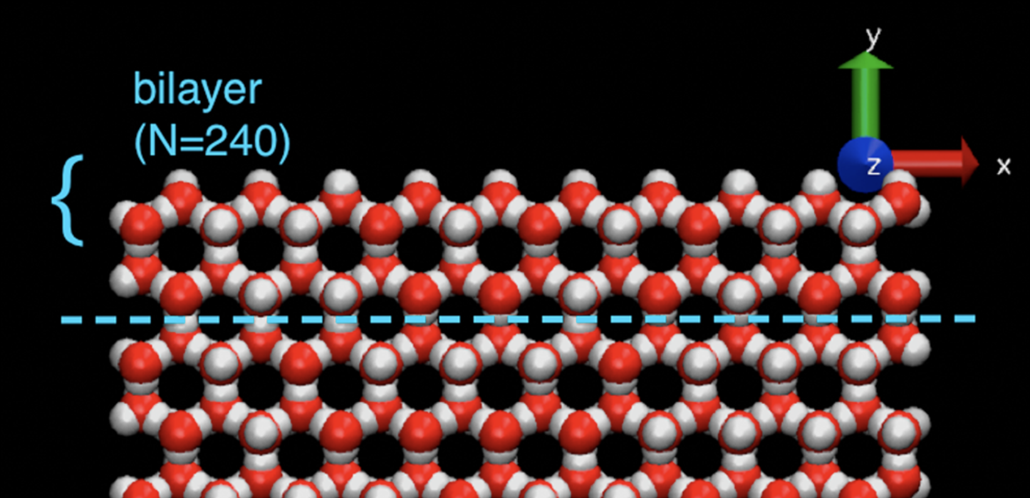

The many scales of ice
Atmospheric
M$esoscopic$
Molecular

Slide 2
Here we’ll focus on molecular and mesoscopic
Atmospheric
M$esoscopic$
Part I:
How do ice surfaces get rough? Actually, how do surfaces remain smooth?
Part II:
What controls the roughness? Actually, what is roughness?
Molecular

Slide 3
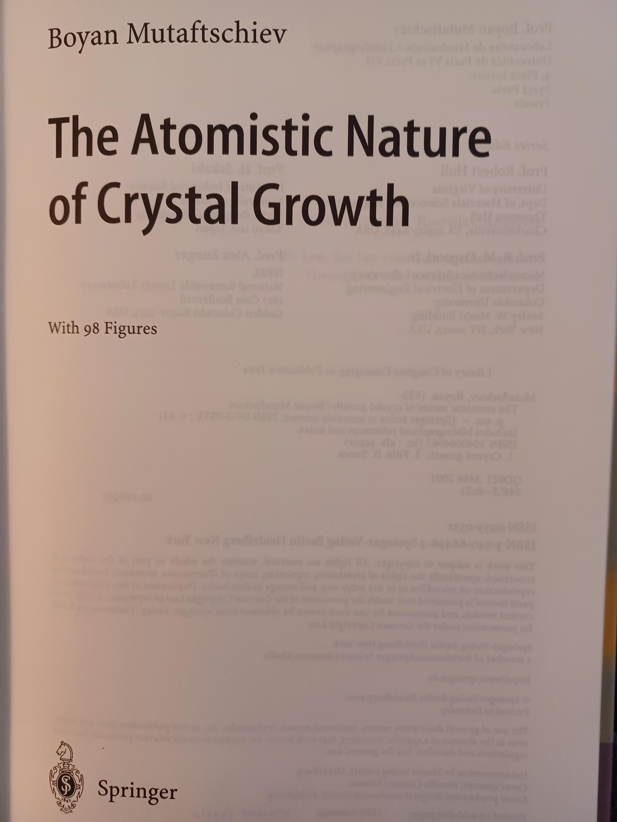
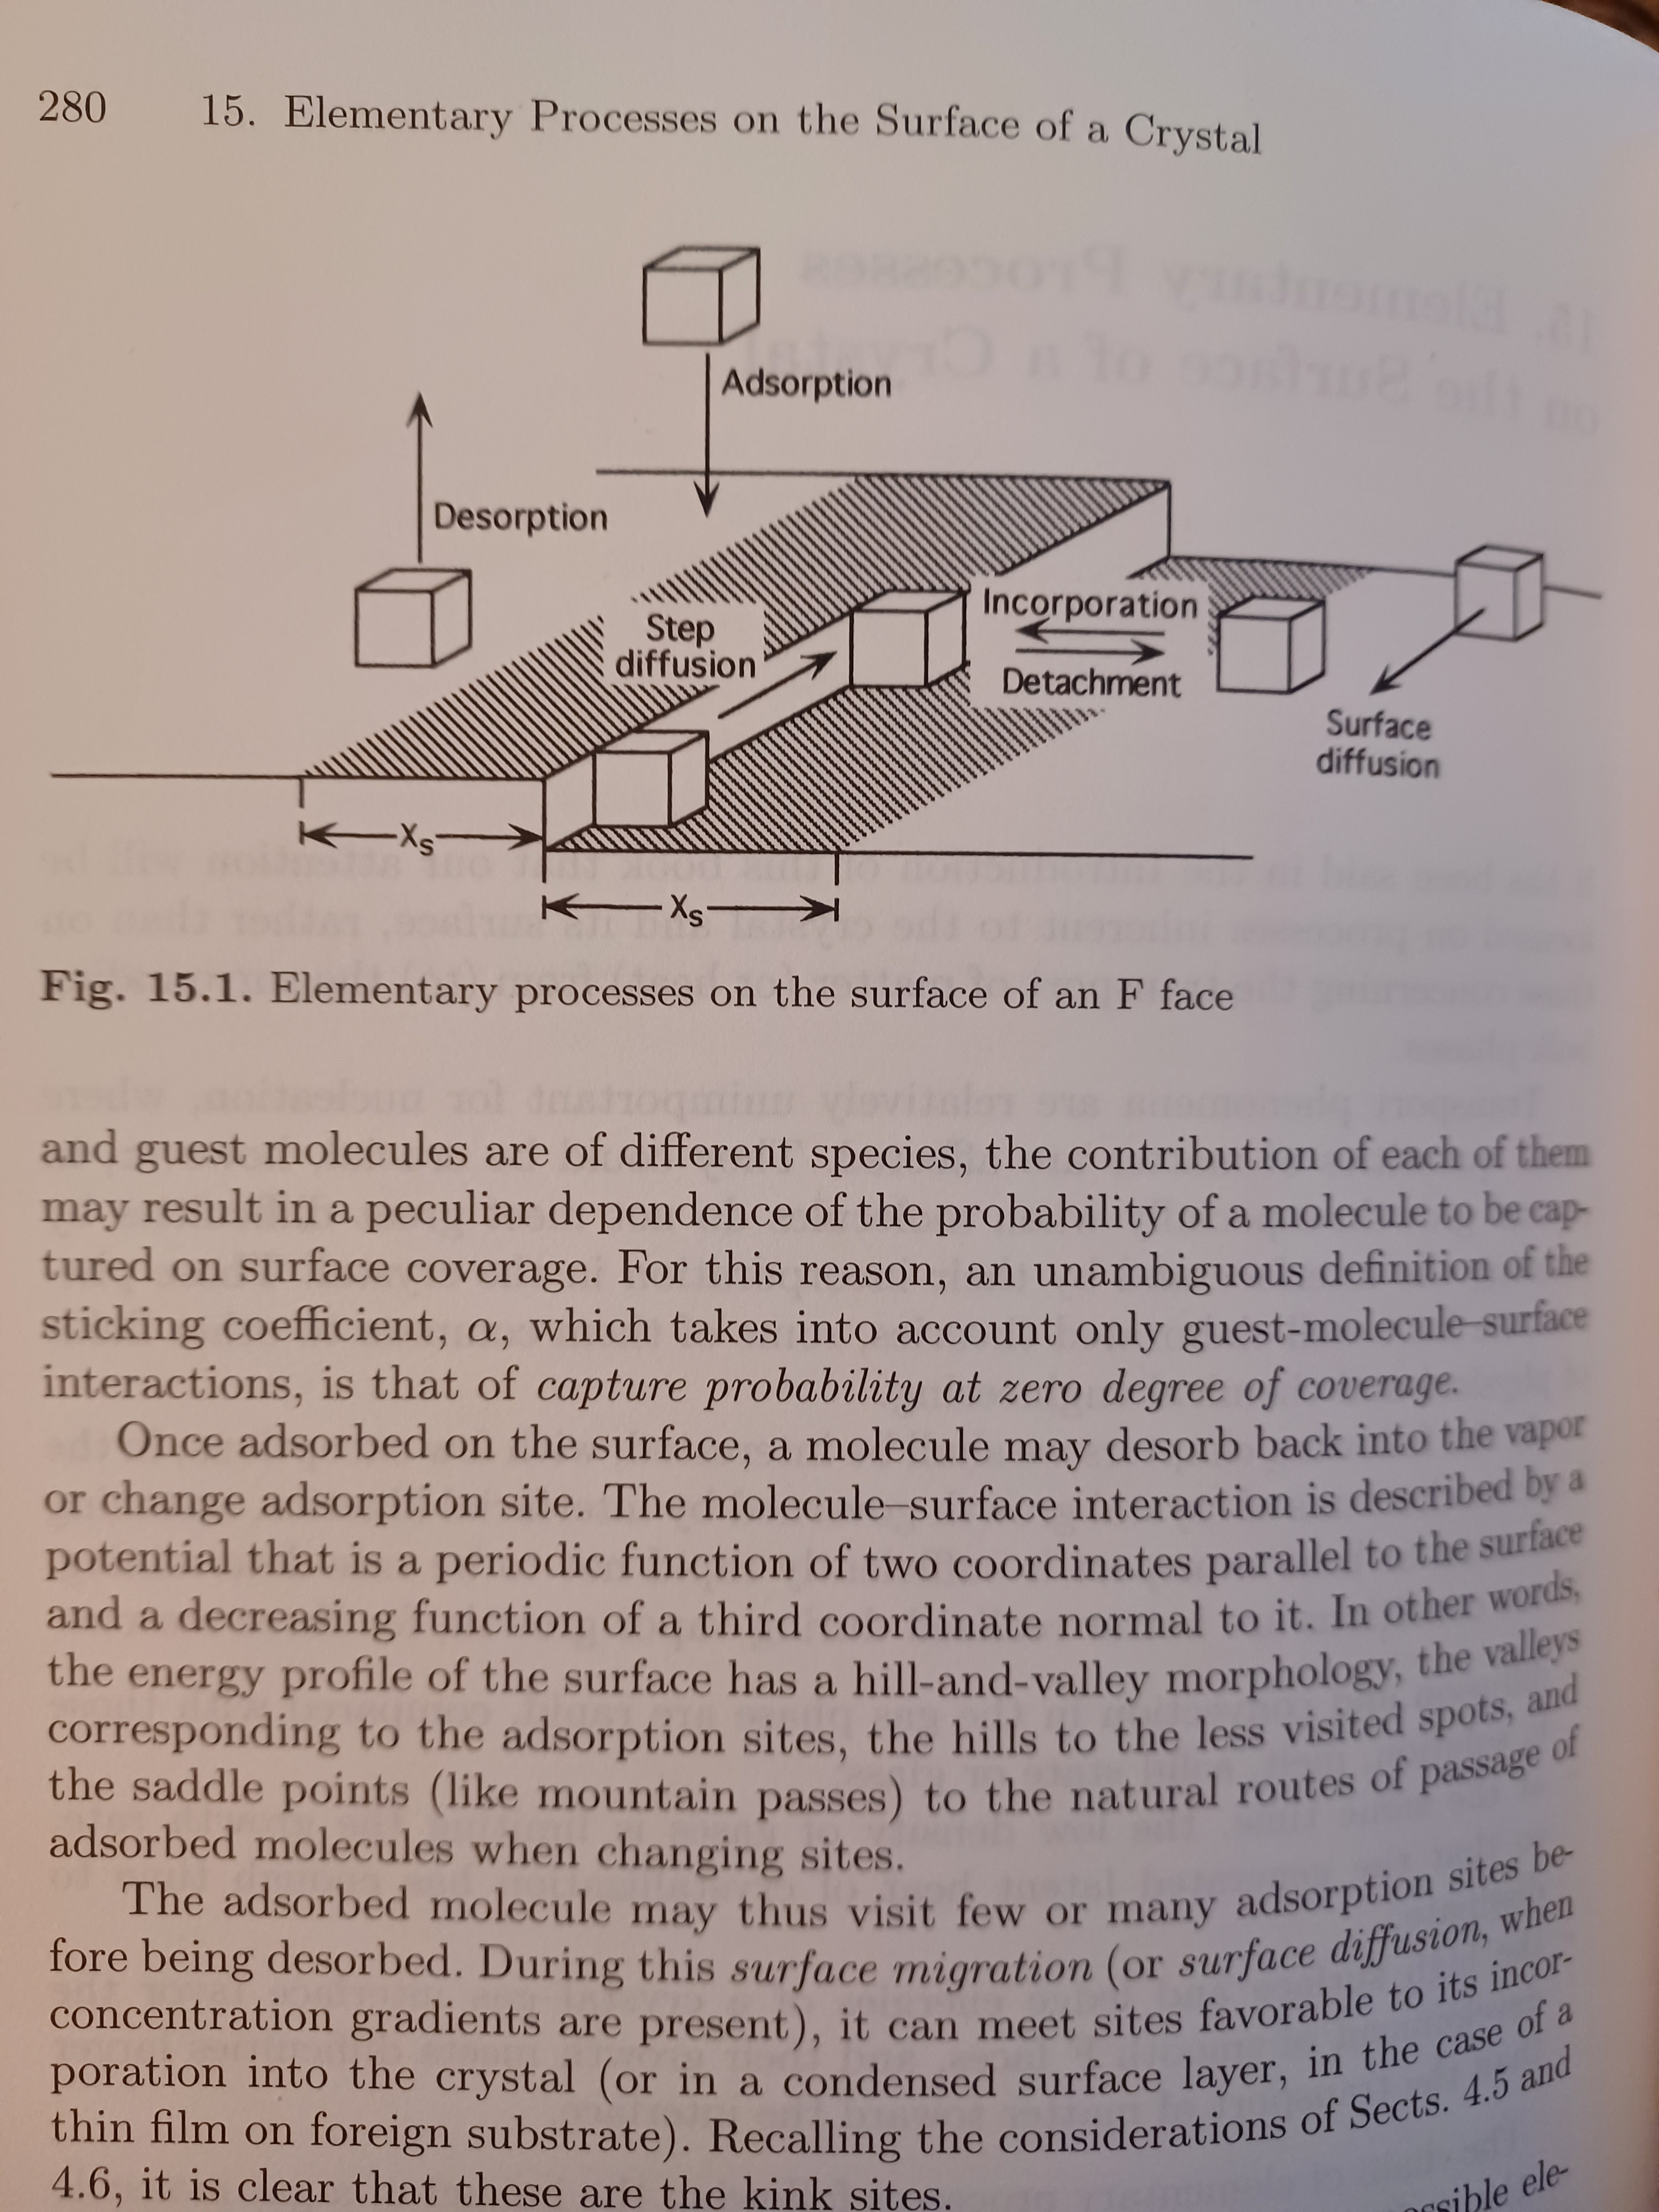
We’d like to describe these behaviors in a way pioneered by BCF (and others) …

Slide 4
We’d like to describe these behaviors in a way pioneered by BCF (and others) …
… But we can’t because of the pesky quasi-liquid layer

Slide 5
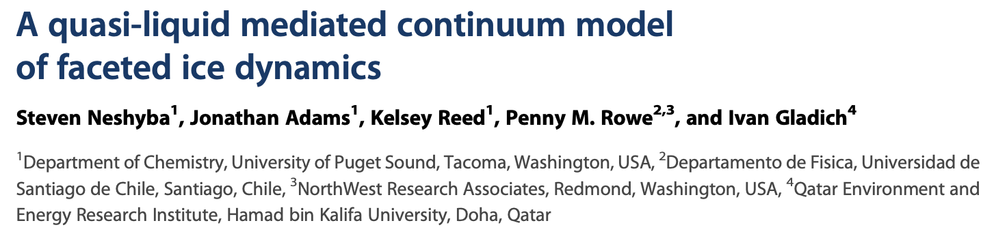
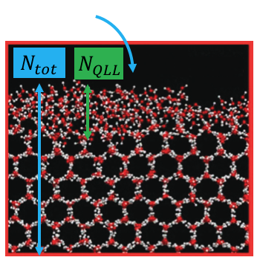
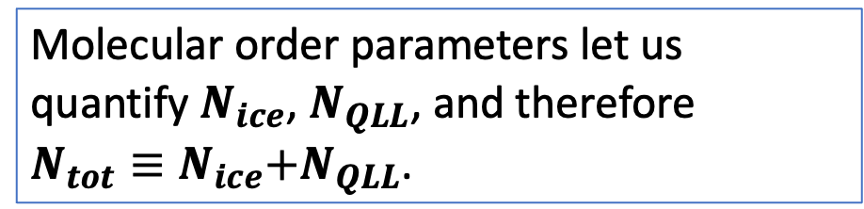
Molecular Dynamics studies of the QLL of water ice
prismatic surface
prismatic surface
Molecular order parameters let us quantify $N_{ice}$, $N_{QLL}$, and therefore
$N_{tot}≡N_{ice}\text{+}N_{QLL}\text{.}$
basal surface
We have a mathematical criterion

Slide 6
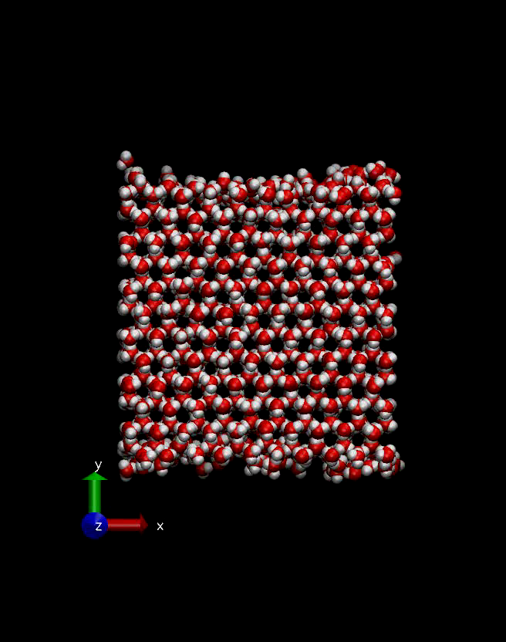
Here are the kind of numerical experiments we did
The time for this simulation is picoseconds, but after a few nanoseconds, we could get “equilibrium” thicknesses of the QLL.
basal surface
We have a mathematical criterion

Slide 7
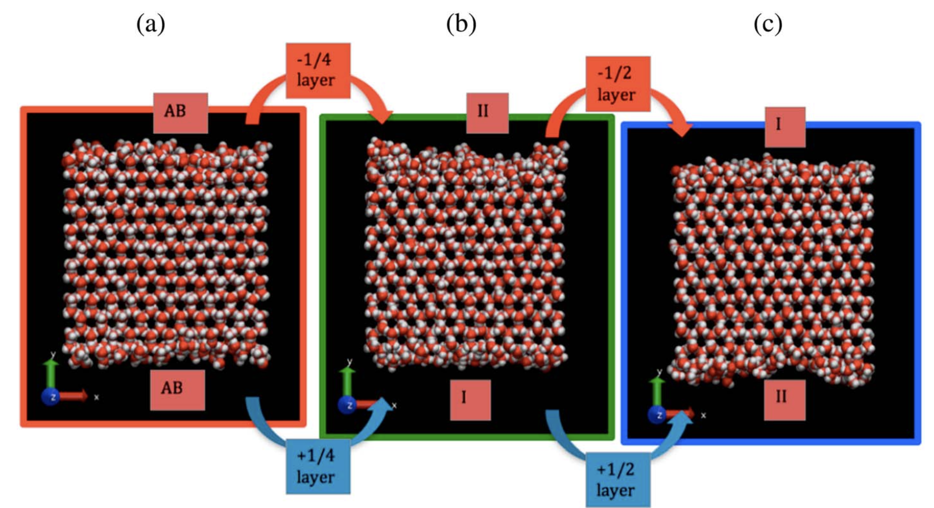
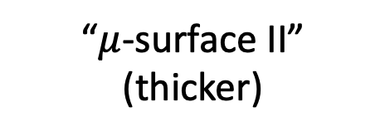
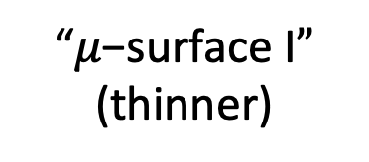
We found a periodic variation in $N_{QLL}^{eq}$ as a function of $N_{tot}$
“$μ\text{−}\text{surface} \text{I}”$
(thinner)
“$μ$-surface II”
(thicker)

Slide 8
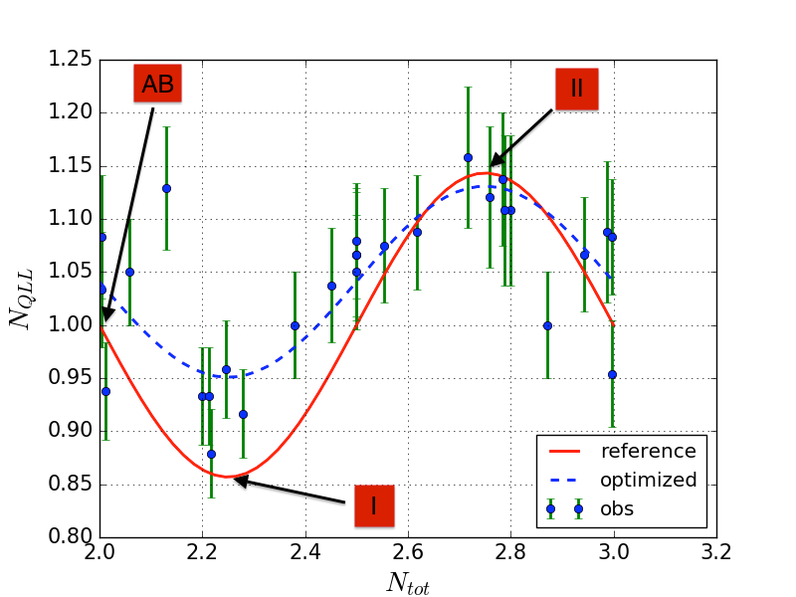
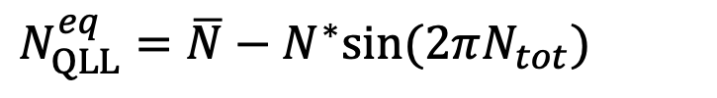
A rough description of that periodicity: a simple sinusoidal function of $N_{tot}$
$N_{QLL}^{eq}=\overline{N}−N^{∗}sin⁡(2πN_{tot})$

Slide 9
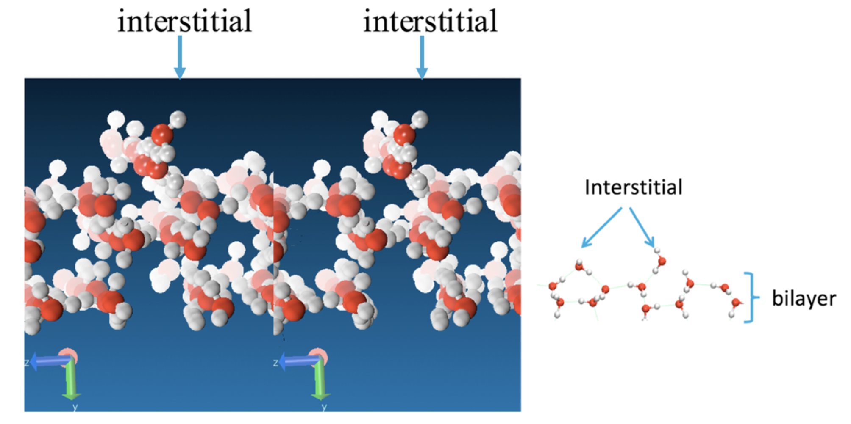
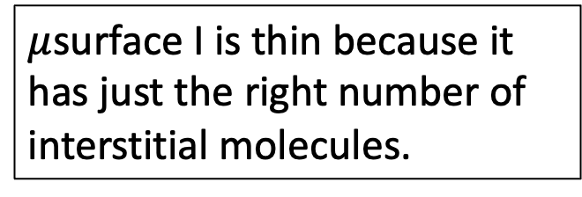
We also think we understood why $μ$surface I is thin
$μ$surface I is thin because it has just the right number of interstitial molecules.

Slide 10
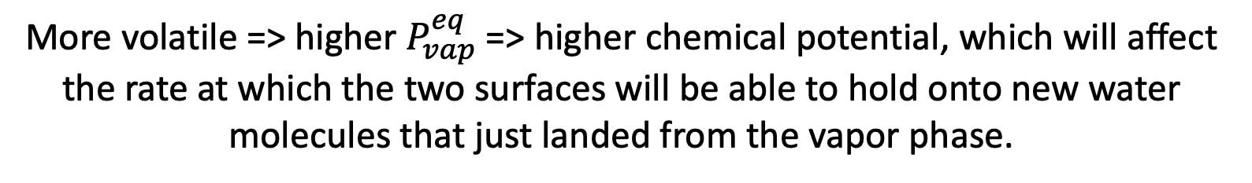


The same simulations also predicted that $μ$surface II is more volatile
$μ$surface II
$μ$surface I
More volatile => higher $P_{vap}^{eq}$ => higher chemical potential, which will affect the rate at which the two surfaces will be able to hold onto new water molecules that just landed from the vapor phase.

Slide 11
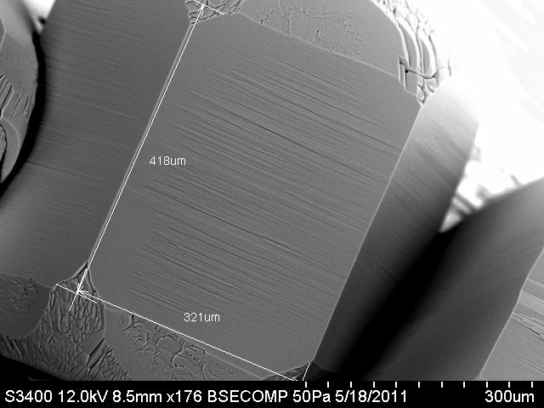
Scaling up from the MD scale to the mesoscale (or SEM scale) in a way that keeps all those insights (but lets go of the details) requires a continuum model of some kind

Slide 12
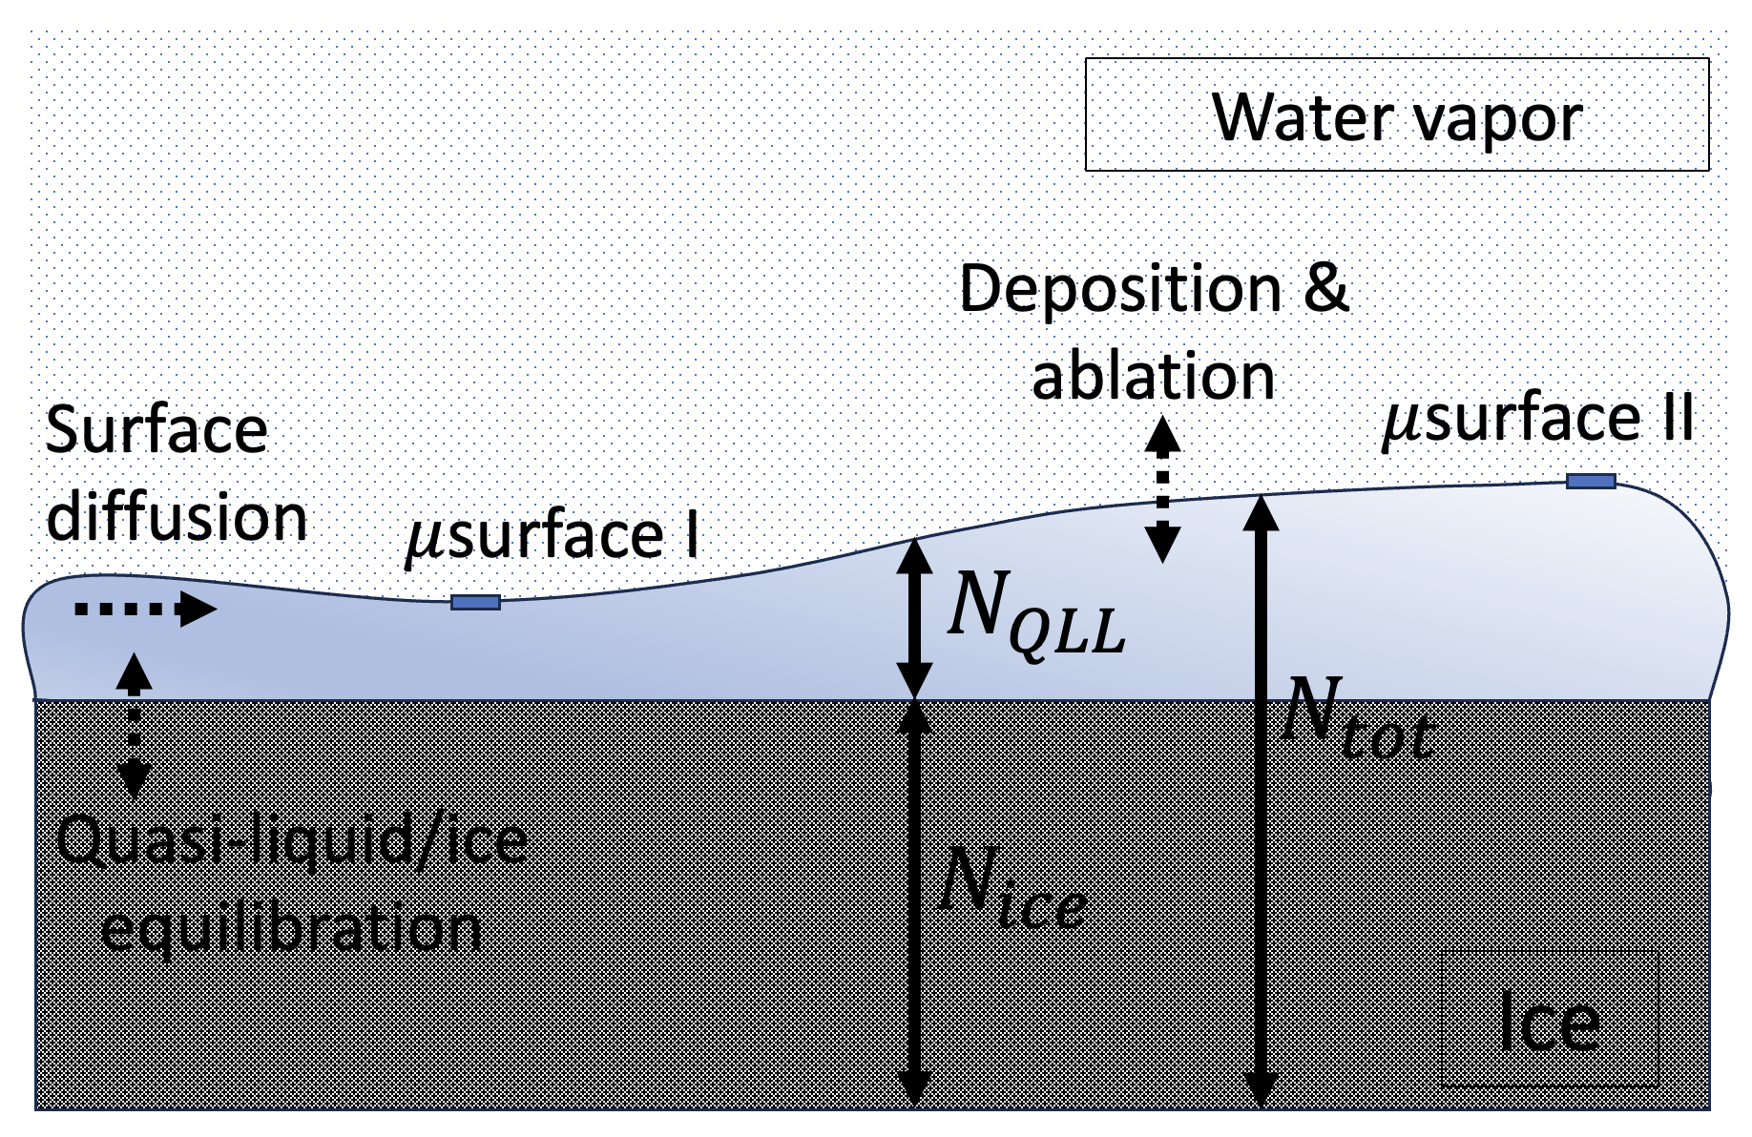
BCF-like processes we’d like to retain in our continuum model

Slide 13
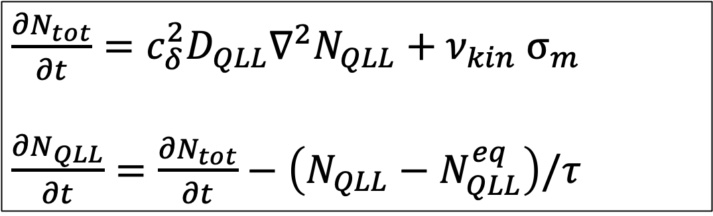
We’ll use two coupled PDEs to represent those processes
$\frac{{∂N}_{tot}}{∂t}={c_{δ}^{2}D}_{QLL}∇^{2}N_{QLL}+ν_{kin}$ $σ_{m}$
$\frac{{∂N}_{QLL}}{∂t}=\frac{{∂N}_{tot}}{∂t}−\left(N_{QLL}−N_{QLL}^{eq}\right)/τ$

Slide 14
Surface diffusion of the QLL
$\frac{{∂N}_{tot}}{∂t}={c_{δ}^{2}D}_{QLL}∇^{2}N_{QLL}+ν_{kin} σ_{m}$
$\frac{{∂N}_{QLL}}{∂t}=\frac{{∂N}_{tot}}{∂t}−\left(N_{QLL}−N_{QLL}^{eq}\right)/τ$

Slide 15
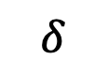
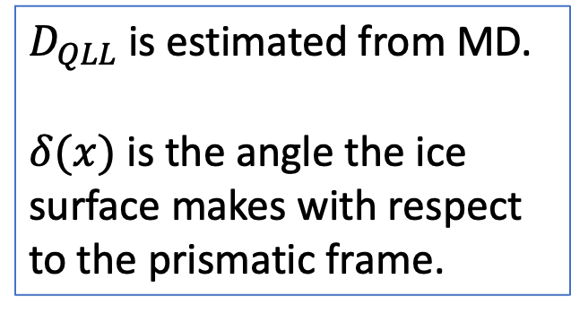
Surface diffusion of the QLL
$\frac{{∂N}_{tot}}{∂t}={c_{δ}^{2}D}_{QLL}∇^{2}N_{QLL}+ν_{kin} σ_{m}$
$\frac{{∂N}_{QLL}}{∂t}=\frac{{∂N}_{tot}}{∂t}−\left(N_{QLL}−N_{QLL}^{eq}\right)/τ$
$D_{QLL}$ is estimated from MD.
$δ(x)$ is the angle the ice surface makes with respect to the prismatic frame.
$$δ$$

Slide 16
Interconversion of quasi-liquid with the underlying ice lattice
$\frac{{∂N}_{tot}}{∂t}={c_{δ}^{2}D}_{QLL}∇^{2}N_{QLL}+ν_{kin} σ_{m}$
$\frac{{∂N}_{QLL}}{∂t}=\frac{{∂N}_{tot}}{∂t}−\left(N_{QLL}−N_{QLL}^{eq}\right)/τ$

Slide 17
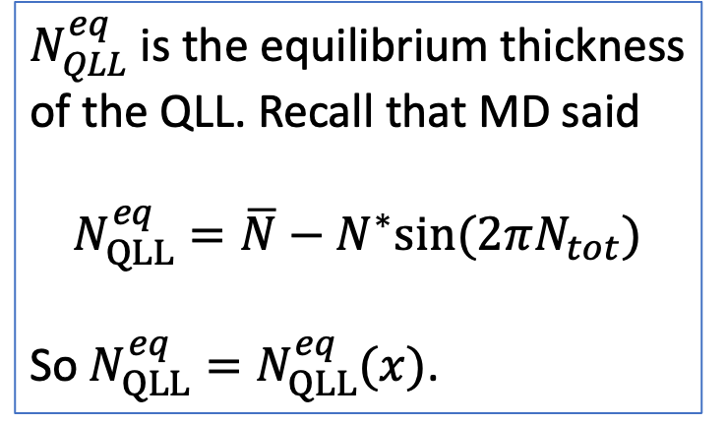
Interconversion of quasi-liquid with the underlying ice lattice
$\frac{{∂N}_{tot}}{∂t}={c_{δ}^{2}D}_{QLL}∇^{2}N_{QLL}+ν_{kin} σ_{m}$
$\frac{{∂N}_{QLL}}{∂t}=\frac{{∂N}_{tot}}{∂t}−\left(N_{QLL}−N_{QLL}^{eq}\right)/τ$
$N_{QLL}^{eq}$ is the equilibrium thickness of the QLL. Recall that MD said
$$N_{QLL}^{eq}=\overline{N}−N^{∗}sin⁡(2πN_{tot})$$
So $N_{QLL}^{eq}=N_{QLL}^{eq}(x)$.

Slide 18
Exchange with the overlying water vapor
$\frac{{∂N}_{tot}}{∂t}={c_{δ}^{2}D}_{QLL}∇^{2}N_{QLL}+ν_{kin} σ_{m}$
$\frac{{∂N}_{QLL}}{∂t}=\frac{{∂N}_{tot}}{∂t}−\left(N_{QLL}−N_{QLL}^{eq}\right)/τ$

Slide 19
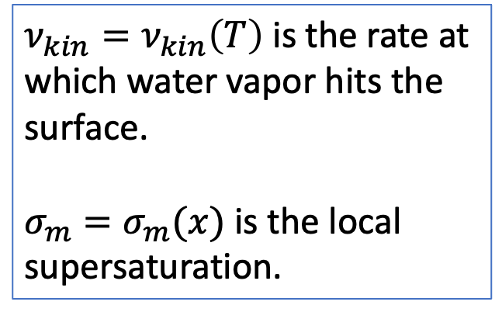
Exchange with the overlying water vapor
$\frac{{∂N}_{tot}}{∂t}={c_{δ}^{2}D}_{QLL}∇^{2}N_{QLL}+ν_{kin} σ_{m}$
$\frac{{∂N}_{QLL}}{∂t}=\frac{{∂N}_{tot}}{∂t}−\left(N_{QLL}−N_{QLL}^{eq}\right)/τ$
$ν_{kin}=ν_{kin}\left(T\right)$ is the rate at which water vapor hits the surface.
$σ_{m}=σ_{m}(x)$ is the local supersaturation.

Slide 20


A little more explanation of $σ_{m}$ … it depends on the overlying vapor pressure
Higher $P_{vap}$
Ice crystal
(2D)

Slide 21
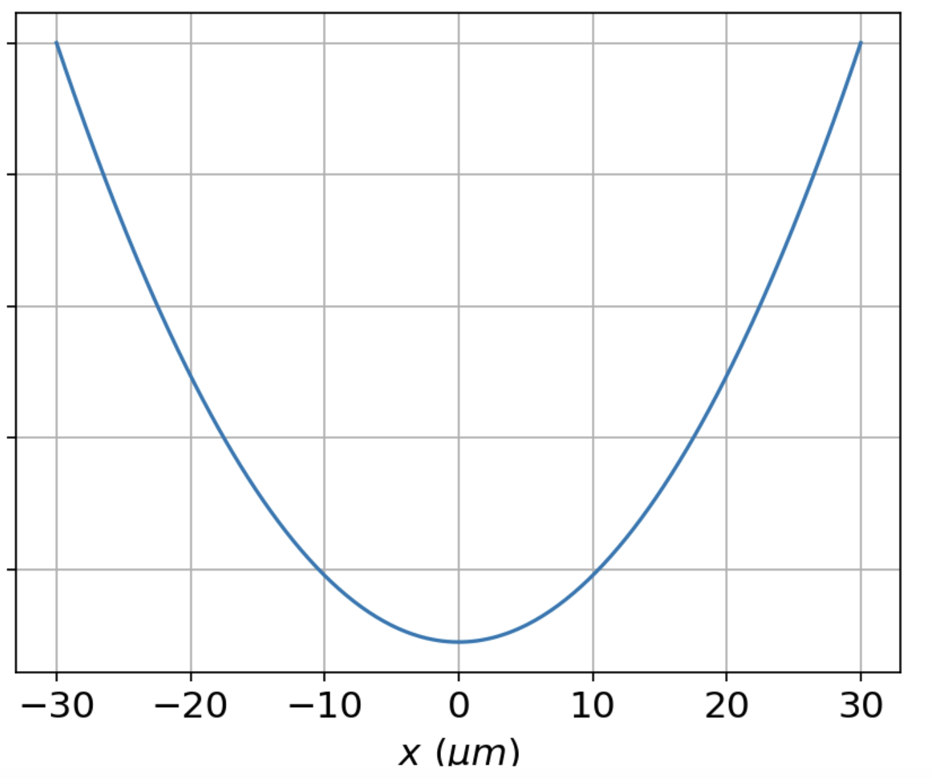
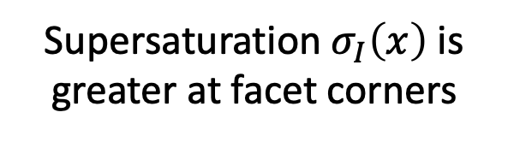
That overlying vapor pressure defines a supersaturation term, $σ_{I}(x)$
Higher $P_{vap}$
Supersaturation $σ_{I}\left(x\right)$ is greater at facet corners
Ice crystal
(2D)

Slide 22
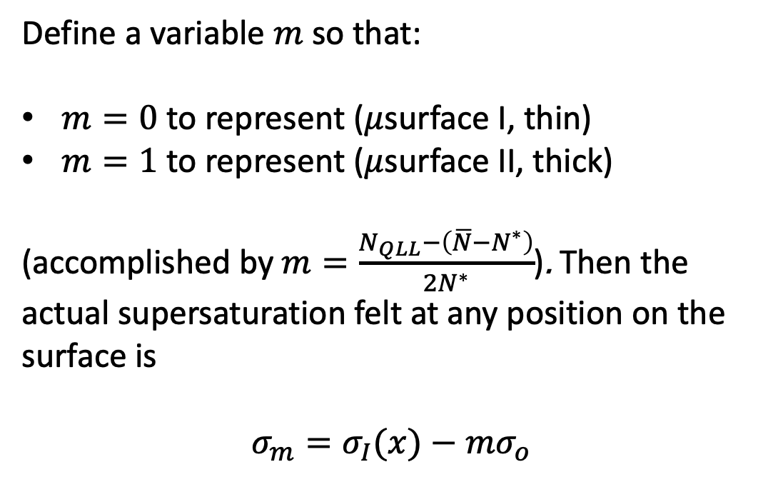
But $σ_{m}$ also depends on the volatility of the QLL
Higher $P_{vap}$
Define a variable $m$ so that:
$m=0$ to represent ($μ$surface I, thin)
$m=1$ to represent ($μ$surface II, thick)
(accomplished by $m=\frac{N_{QLL}−\left(\overline{N}−N^{∗}\right)}{2N^{∗}}$). Then the actual supersaturation felt at any position on the surface is
$$σ_{m}=σ_{I}(x)−mσ_{o}$$
Ice crystal
(2D)

Slide 23
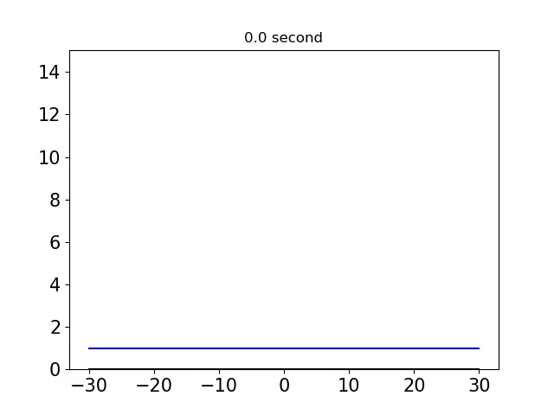
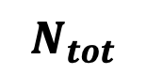
OK, let’s look at some results – solving the PDE starting with a flat surface
$$N_{tot}$$

Slide 24
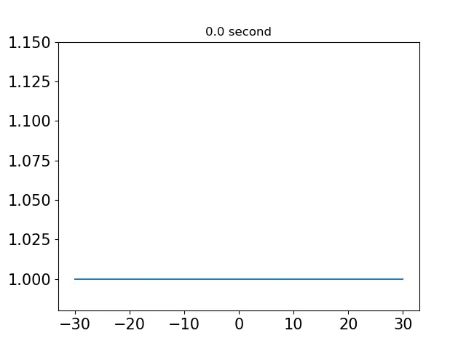
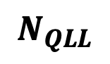
OK, let’s look at some results – solving the PDE starting with a flat surface
$$N_{QLL}$$

Slide 25
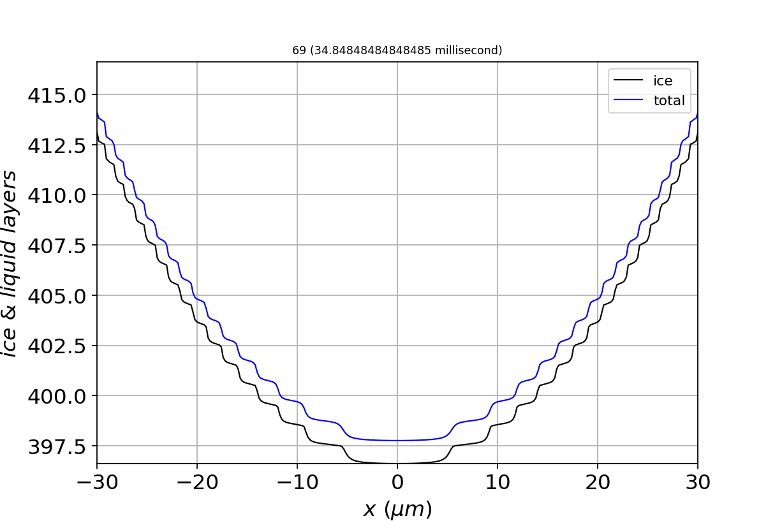
Steps correspond to mainly $μ$surface I (thin QLL)

Slide 26
Terraces correspond to mainly $μ$surface II (thick QLL)

Slide 27
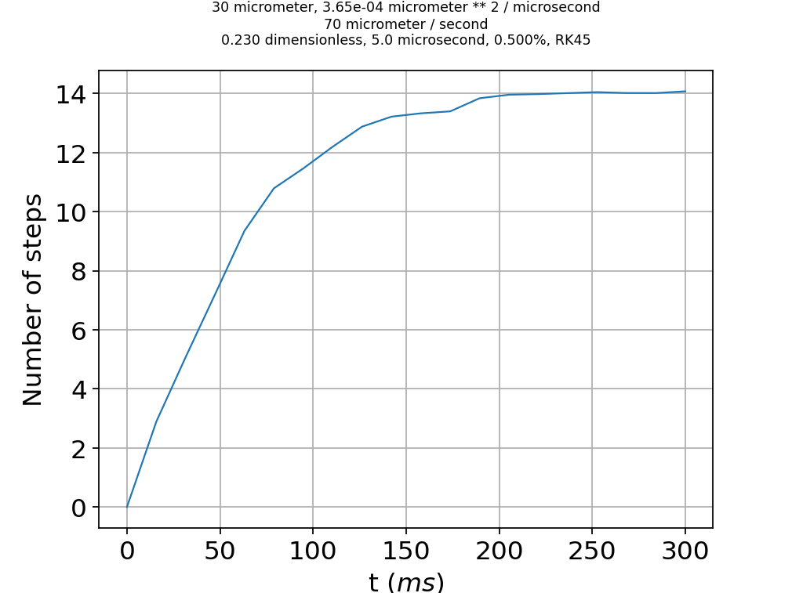
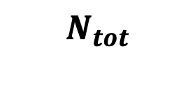
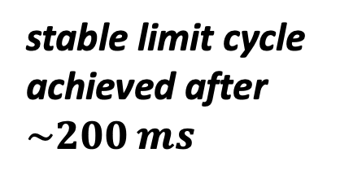
About that convergence … it’s a stable limit cycle
$$N_{tot}$$
stable limit cycle achieved after $\sim 200 ms$

Slide 28
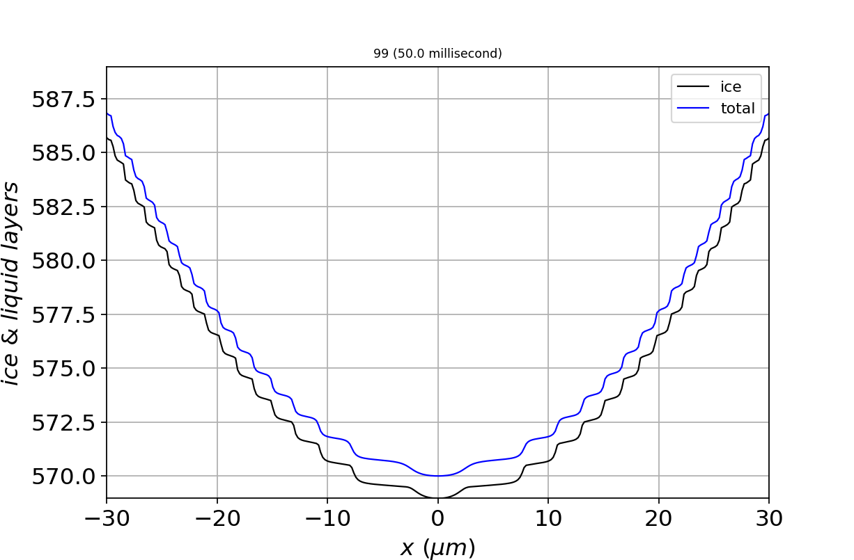
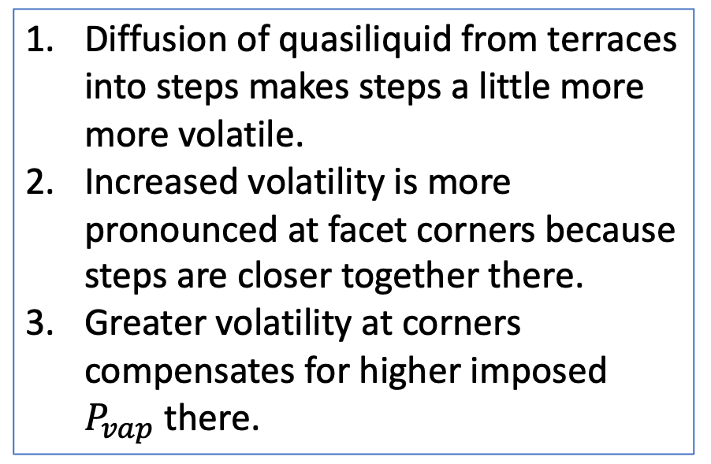
Mechanism: surface diffusion modifies the surface in response to vapor inhomogeneity
Diffusion of quasiliquid from terraces into steps makes steps a little more more volatile.
Increased volatility is more pronounced at facet corners because steps are closer together there.
Greater volatility at corners compensates for higher imposed $P_{vap}$ there.

Slide 29
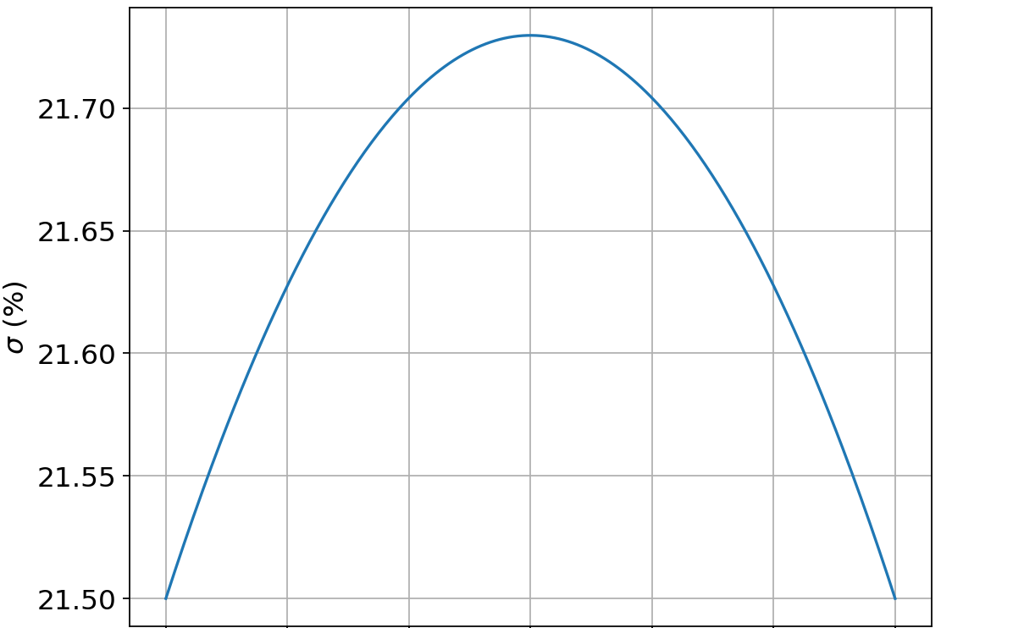
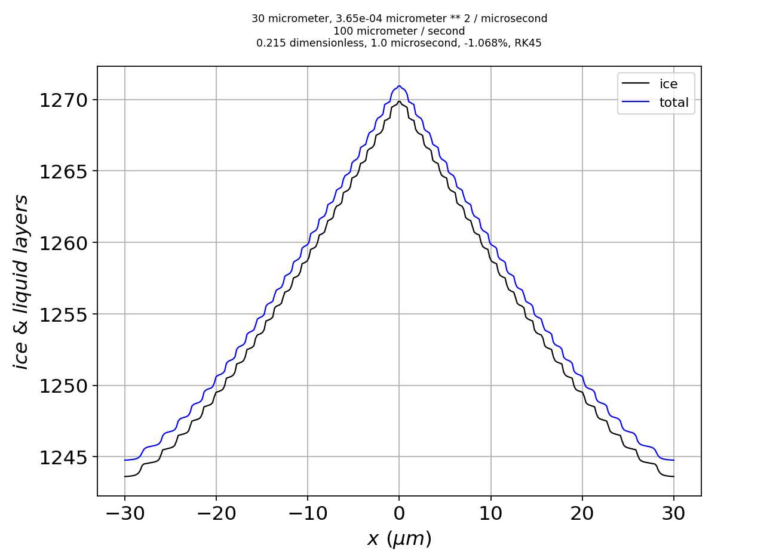
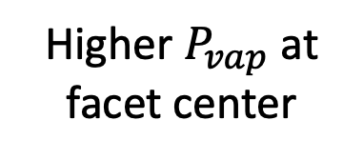
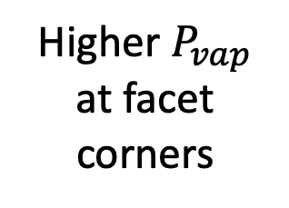
The same mechanism works with any smooth inhomogeneity in the overlying vapor field
Imposed supersaturation
Shape of the converged surface
Higher $P_{vap}$ at facet corners
Limit cycle has convex curvature
Higher $P_{vap}$ at facet center
Limit cycle has concave curvature

Slide 30
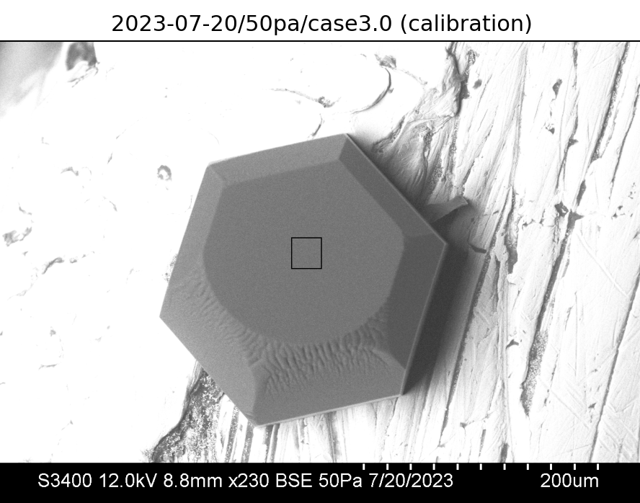
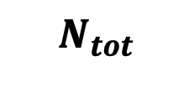
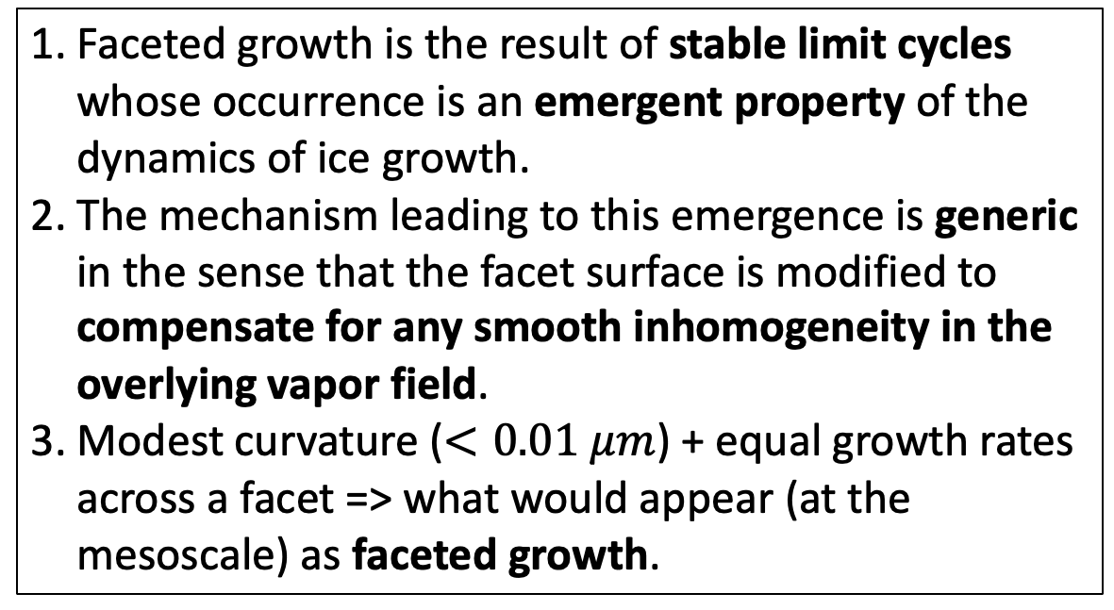
Take-home lesson from Part 1: limit cycling explains faceted growth
$$N_{tot}$$
1. Faceted growth is the result of stable limit cycles whose occurrence is an emergent property of the dynamics of ice growth.
2. The mechanism leading to this emergence is generic in the sense that the facet surface is modified to compensate for any smooth inhomogeneity in the overlying vapor field.
3. Modest curvature ($<0.01 μm$) + equal growth rates across a facet => what would appear (at the mesoscale) as faceted growth.

Slide 31

On to Part II
$$mesoscopic scale$$
(from scanning electron microscopy)
Part I:
How do surfaces get rough? Actually, how do surfaces remain smooth?
Part II:
What controls the roughness? Actually, what is roughness?
Molecular scale

Slide 32
Hypothesis: maybe roughness is “just” microfacets of other angles

Slide 33
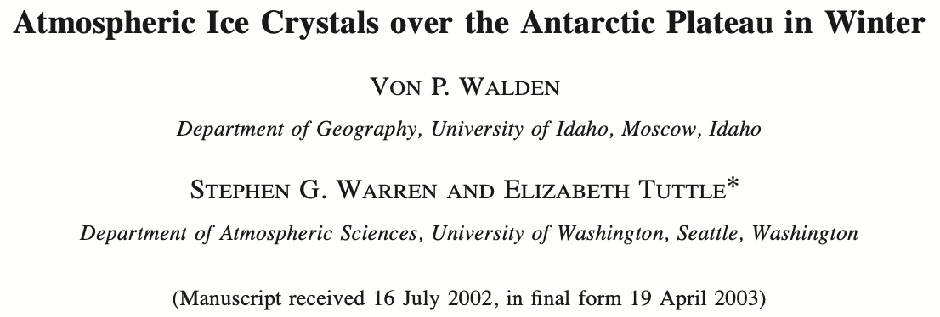
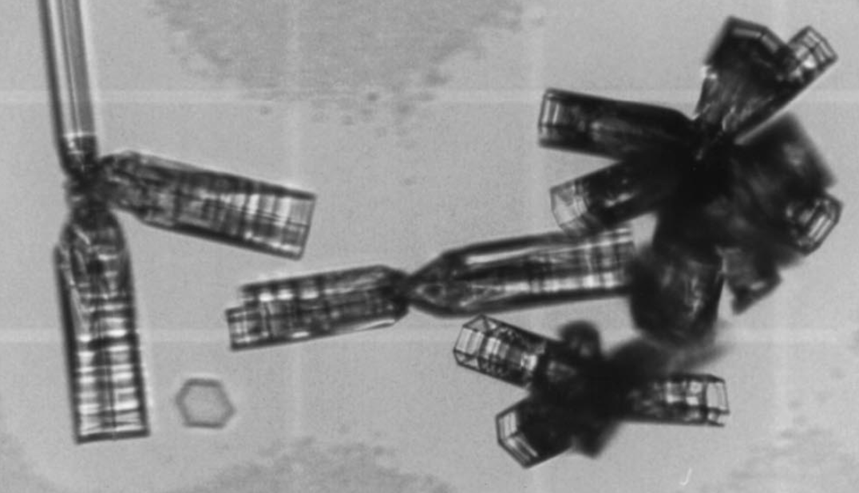
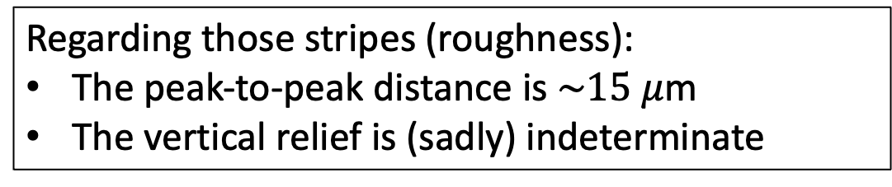
Why? Optical microscopy tells us there are characteristic peak-to-peak distances
Crystal habit (columns vs plates)
Hollowing
Roughness
Regarding those stripes (roughness):
The peak-to-peak distance is $\sim 15 μ$m
The vertical relief is (sadly) indeterminate

Slide 34
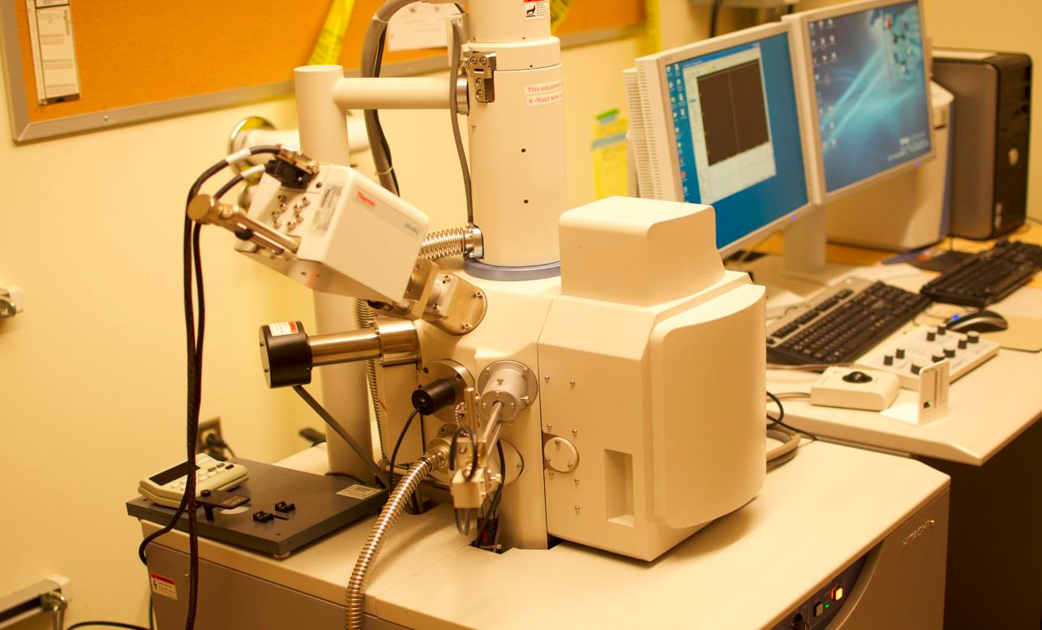

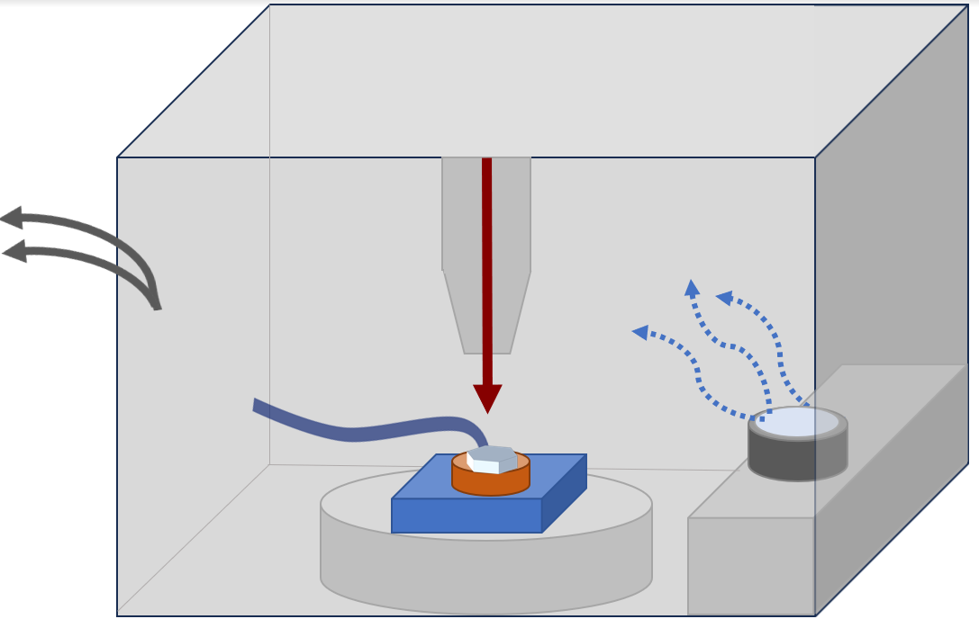
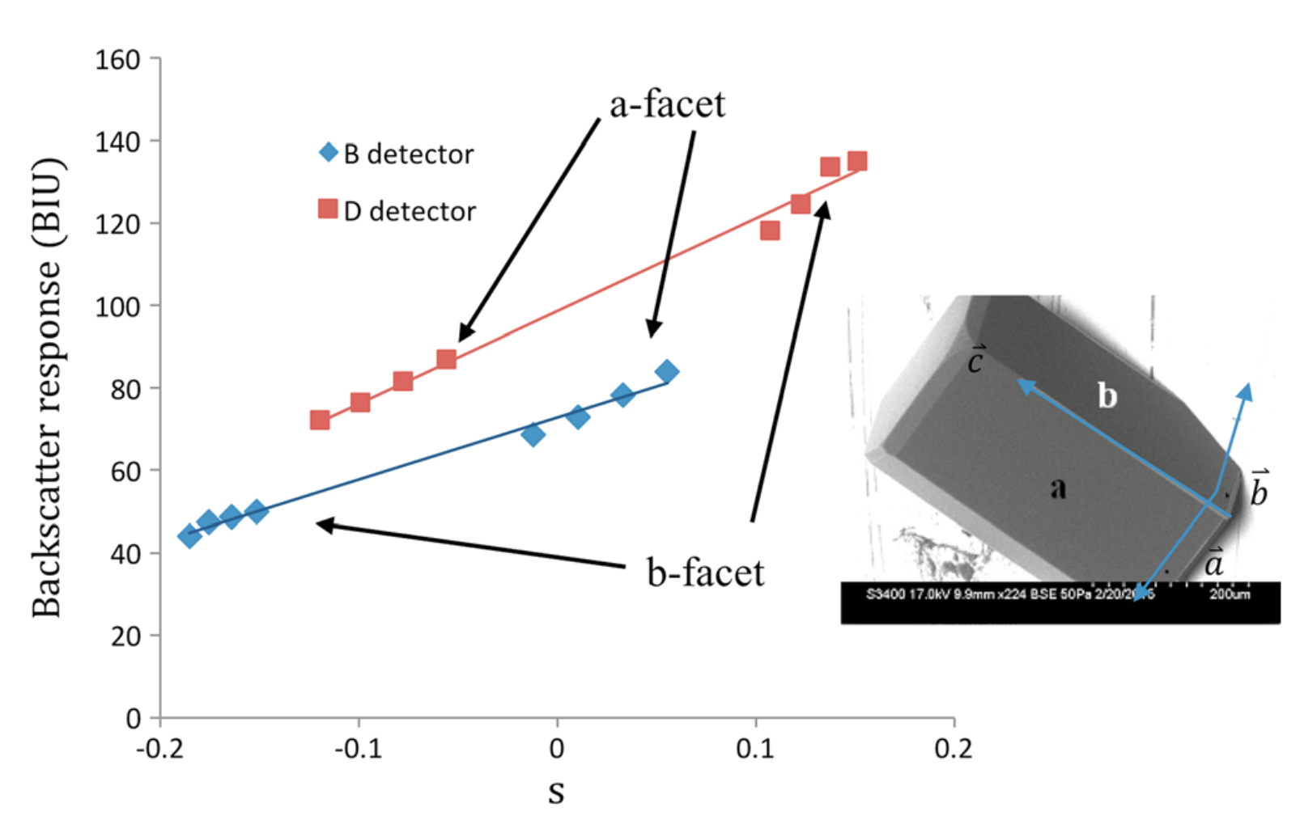
SEM/GNBF gives us surface structure
Vacuum

Slide 35




SEM/GNBF gives us the angles too
Horizontal Peak-to-peak distance $\sim 50 μ$m
Vertical relief $\sim 7 μ$m
=> Slope $\sim 10°$

Slide 36



SEM/GNBF gives us the angles too
Horizontal Peak-to-peak distance $\sim 15 μ$m
Vertical relief $\sim 1−2 μ$m
=> Slope $\sim 10°$

Slide 37

Modifying our PDE to enable microfaceting …
Ice surface
Prismatic monolayer ($h_{pr})$

Slide 38


Red lines indicate successive layers of a different crystallographic plane, of thickness $h_{θ}$
$$h_{θ}$$
$$θ$$
We’ll refer to this new crystallographic plane “pyramidal” or “$θ$-like”

Slide 39

Red lines indicate successive layers of a different crystallographic plane, of thickness $h_{θ}$
$$h_{θ}$$
$$θ$$
We’ll refer to this new crystallographic plane “pyramidal” or “$θ$-like”

Slide 40


Our strategy: keep the form of the PDE, but make key parameters (${\tilde{σ}}_{m}$ and ${\tilde{N}}_{QLL}^{eq}$) dynamic
$$θ$$
$\frac{{∂N}_{tot}}{∂t}={c_{δ}^{2}D}_{QLL}∇^{2}N_{QLL}+ν_{kin}$ $σ_{m}$
$\frac{{∂N}_{QLL}}{∂t}=\frac{{∂N}_{tot}}{∂t}−\left(N_{QLL}−N_{QLL}^{eq}\right)/τ$
$\frac{{∂N}_{tot}}{∂t}={c_{δ}^{2}D}_{QLL}∇^{2}N_{QLL}+ν_{kin}$ ${\tilde{σ}}_{m}$
$\frac{{∂N}_{QLL}}{∂t}=\frac{{∂N}_{tot}}{∂t}−\left({∂N}_{QLL}−{\tilde{N}}_{QLL}^{eq}\right)/τ$

Slide 41

For ${\tilde{N}}_{QLL}^{eq}$: First we need to compute the layer thicknesses ($N_{tot}$) at each grid point
$$θ$$
At the dot, $N_{tot,pr}=3$ and $N_{tot,θ}=2$
More generally, $N_{tot,±θ}(x)=\frac{1}{h_{θ}}\left(c_{θ}h_{pr}N_{tot,pr}±s_{θ}x\right)$

Slide 42

For ${\tilde{N}}_{QLL}^{eq}$: $N_{tot}(x)$ gets us equilibrium QLL thicknesses for any given facet angle
$$θ$$
$N_{QLL,pr}^{eq}(x)=\overline{N}−N_{pr}^{∗}sin⁡(2πN_{tot,pr}(x))$
$N_{QLL,±θ}^{eq}(x)=\overline{N}−N_{±θ}^{∗}\sin\left(2πN_{tot,±θ}(x)\right)$

Slide 43
For ${\tilde{N}}_{QLL}^{eq}$: Then we’ll weight them (“$α$”)
$$θ$$
$${\tilde{N}}_{QLL}^{eq}(x)={{α_{θ}N}_{QLL,θ}^{eq}\left(x\right)+α_{pr}N}_{QLL,pr}^{eq}\left(x\right)+{α_{−θ}N}_{QLL,−θ}^{eq}(x)$$

Slide 44

For ${\tilde{σ}}_{m}$: Each facet angle gets an $N^{∗}$ and $σ_{o}$
$$θ$$
$σ_{m,pr}\left(x\right)=σ_{I}\left(x\right)−\frac{N_{QLL}(x)−\left(\overline{N}−N_{pr}^{∗}\right)}{2N_{pr}^{∗}}σ_{o,pr}$
$σ_{m,±θ}\left(x\right)=σ_{I}\left(x\right)−\frac{N_{QLL}(x)−\left(\overline{N}−N_{±θ}^{∗}\right)}{2N_{±θ}^{∗}}σ_{o,±θ}$

Slide 45
For ${\tilde{σ}}_{m}$: Then we’ll weight them (“$α$”)
$$θ$$
${\tilde{σ}}_{m}={α_{θ}σ}_{m,θ}+α_{pr}σ_{m,pr}+{α_{−θ}σ}_{m,−θ}$

Slide 46


We need those weights $α_{±θ}$ & $α_{pr}$
Slopes: $\frac{dz_{pr}}{dx}≡β$
$$θ$$
Each grid point has a slope ($β$)

Slide 47
Assign the weights according to the slope of the surface
Slopes: $\frac{dz_{pr}}{dx}≡β$
$$θ$$
Here, $β≈β_{θ}$, so the grid point aligns with the positively-sloped $θ$ (“pyramidal”) facet

Slide 48
Assign the weights according to the slope of the surface
Slopes: $\frac{dz_{pr}}{dx}≡β$
$$θ$$
Here, $β≈0$, so we’d say the grid point aligns best with the original facet (prismatic)

Slide 49
Assign the weights according to the slope of the surface
Slopes: $\frac{dz_{pr}}{dx}≡β$
$$θ$$
$β≈{−β}_{θ}$ so the grid point aligns with the negatively-sloped $θ$ facet

Slide 50






Assign weights using sigmoid functions ($α_{θ}$, $α_{pr}$, $α_{−θ}$)
$$α_{θ}≈0.9$$
$α_{pr}$ $≈0.1$
$α_{−θ}≈0.0$
$$α\left(β\right)=1−\frac{1}{1+e^{−\frac{β−β_{θ/2}}{∆β}}}$$
$${−β}_{θ/2}$$
$$0$$
$$β_{θ/2}$$

Slide 51
Each grid point can now be assigned a set of weights ($α_{pr}$, $α_{θ}$, $α_{−θ}$)
$$α_{θ}≈0.9$$
$α_{pr}$ $≈0.1$
$α_{−θ}≈0.0$
$$θ$$

Slide 52

Using the weights ($α$), we compute weighted averages
$$α_{θ}≈0.9$$
$α_{pr}$ $≈0.1$
$α_{−θ}≈0.0$
$$θ$$
${\tilde{σ}}_{m}={α_{θ}σ}_{m,θ}+α_{pr}σ_{m,pr}+{α_{−θ}σ}_{m,−θ}$
(similar for ${\tilde{N}}_{QLL}^{eq}$)

Slide 53
Now we have all the pieces needed to explore dynamics of the microfacet-enabled model
$$θ$$
$\frac{{∂N}_{tot}}{∂t}={c_{δ}^{2}D}_{QLL}∇^{2}N_{QLL}+ν_{kin}$ $σ_{m}$
$\frac{{∂N}_{QLL}}{∂t}=\frac{{∂N}_{tot}}{∂t}−\left(N_{QLL}−N_{QLL}^{eq}\right)/τ$
$\frac{{∂N}_{tot}}{∂t}={c_{δ}^{2}D}_{QLL}∇^{2}N_{QLL}+ν_{kin}$ ${\tilde{σ}}_{m}$
$\frac{{∂N}_{QLL}}{∂t}=\frac{{∂N}_{tot}}{∂t}−\left({∂N}_{QLL}−{\tilde{N}}_{QLL}^{eq}\right)/τ$

Slide 54




Limit cycling without microfaceting
Notes: The trajectory indicates a limit cycle is achieved after about $200 ms.$

Slide 55





Limit cycling with microfaceting
Notes: The trajectory indicates a limit cycle is achieved after about $200 ms$. Evidence of microfaceting is seen in the early stages of $N_{QLL}$ profile development, here at 27 ms. Results are very similar when sigma0factor is increased to 1.2, which leads to no-growth microfacets.

Slide 56





Growable $θ=±5°$ microfaceting, fast-growth conditions
Notes: We’ve switched to a bigger scale for $N_{tot}$ here. We infer that the trajectory indicates a limit cycle after about $3 s$, for the following reasons: (1) The profile (upper left figure) is more or less constant over time with the number of steps having reached a plateau (see figure above). However, (2) The surface itself keeps growing (not shown), and the variability in $N_{QLL}$ is expected of a growing facet (see figure at left).

Slide 57





Non-growable $θ=±5°$ microfaceting, fast-growth conditions
Notes: The difference here is that the $±5°$ microfacets have a higher value of $σ_{o}$, such that they have negative supersaturation. The profile (upper left figure) is more or less constant over time, with the number of steps having reached a plateau by about $1.3 s$ (see figure above). That, together with the smoothness of $N_{tot}$ and the lack of variability of $N_{QLL}$ (figure at left -- hovering around $1.08$), indicate a steady state.

Slide 58





Other angles: $θ=±10°$ microfaceting (non-growable)
$${h_{pr}N}_{tot,pr}$$

Slide 59





Other angles: $θ=±20°$ microfaceting (non-growable)
$${h_{pr}N}_{tot,pr}$$

Slide 60




Other angles: $θ=±30°$ microfaceting (non-growable)
$${h_{pr}N}_{tot,pr}$$

Slide 61


Take-home lessons
From Part I:
1. Faceted ice growth is the result of stable limit cycles, whose occurrence is an emergent property of the dynamics of ice growth.
2. The mechanism leading to this emergence is generic in the sense that the facet surface is modified to compensate for any smooth inhomogeneity in the overlying vapor field.
From Part II:
1. Roughness is consistent with microfacet formation modulating otherwise flat faceted surfaces.
2. Microfacets stabilize the surface in that they enable limit cycle profiles when the microfacets are supersaturated, or static profiles when undersaturated.
3. Available in situ (visible, SEM/GNBF) experiments suggest a predominance of $θ≈10°$ microfacet on prismatic facets in the principle (c) axis direction.

Slide 62




Going forward …
Model:
How do the surrounding vapor fields really vary for growing or ablating crystals?
What insights might a Fourier formulation provide?
What about a PDE for two-dimensional crystal surfaces?
Observations:
What range are observed microfacet angles?
What happens in subsaturated conditions?
More broadly:
Can we use this theory to predict optical properties of cirrus ice in a way that’s useful to climate science?
Atmospheric

Slide 63

Thanks for listening!
$\frac{{∂N}_{tot}}{∂t}={c_{δ}^{2}D}_{QLL}∇^{2}N_{QLL}+ν_{kin}$ ${\tilde{σ}}_{m}$
$\frac{{∂N}_{QLL}}{∂t}=\frac{{∂N}_{tot}}{∂t}−\left({∂N}_{QLL}−{\tilde{N}}_{QLL}^{eq}\right)/τ$

Slide 64


Can we use this theory to usefully predict statistics of ice facet roughness?
There are SEM and in situ cirrus cloud observations to compare to, so that’s good. But there are lots of outstanding questions …
How does microfaceting (hence, roughness) depend on other parameters, like the imposed supersaturation and temperature?
What about multiple microfacet angles ($±θ_{1}$, $±θ_{2}$, etc.)?
What about two-dimensional crystal surfaces?
What about rimming and hollowing?
What happens in subsaturated conditions? (So far, we have computational results only for mildly supersaturated conditions.)
How good is the assumption that the imposed vapor field varies with positive curvature for growing crystals?

Slide 65

We do get positive curvature on “flat” basal facets, although it’s a lot bigger and bumpier than stable limit-cycle theory predicts

Slide 66


The beginnings of hollowing when $ν_{kin}$ gets big (higher temperature)
$$≈0.2 μm$$

Slide 67



Molecular Dynamics studies of ice surfaces
December 2016

Slide 68



$θ=±10°$ microfaceting enabled, after 10 seconds simulated time (w/o D correction)
The vertical scale is in $μm$ here, x1000s greater than what I showed you before; it would be visible on a microscopic (e.g., SEM) scale.
It would develop a steady state.
$${h_{pr}N}_{tot,pr}$$

Slide 69





Steps are characterized by thin quasiliquid (i.e., $μ$surface I)
$μ$surface I
$$N_{tot}$$
$$N_{QLL}$$

Slide 70
Steps are characterized by thin quasiliquid (i.e., $μ$surface I)
$μ$surface I
$$N_{tot}$$
$$N_{QLL}$$

Slide 71
Steps are characterized by thin quasiliquid (i.e., $μ$surface I)
$μ$surface I
$$N_{tot}$$
$$N_{QLL}$$

Slide 72

Terraces are characterized by thick quasiliquid (i.e., $μ$surface II)
$μ$surface II
$$N_{tot}$$
$$N_{QLL}$$

Slide 73
Terraces are characterized by thick quasiliquid (i.e., $μ$surface II)
$μ$surface II
$$N_{tot}$$
$$N_{QLL}$$

Slide 74
Terraces are characterized by thick quasiliquid (i.e., $μ$surface II)
$μ$surface II
$$N_{tot}$$
$$N_{QLL}$$

